Slide 1
Build Tools & Package Manager

Slide 2
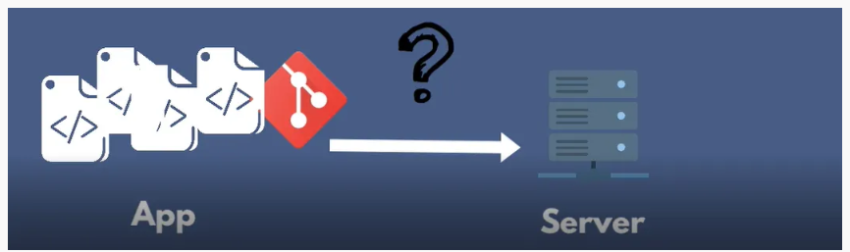
What are Build Tools and Package Managers?
The application needs to be deployed on the production server. For that, we want to package an application into a single moveable file (artifact), also called "building the code" this is what a build tool or package manager tool does.

Slide 3
"What are Build Tools and Package Managers?
How to build an artifact?
How to run the application artifact?
How to publish the application artifact to the artifact repository?
Build Tool for Java (maven examples)
Dependency Management in Software Development
Package Manager in JavaScript applications - Build and run applications in JS (npm)
Python Build Tools (PIP)
Why Build Tools are relevant for DevOps Engineers?"

Slide 4
What is an "artifact"?
Artifact includes application code and all its dependencies
What is inside a jar file?
A jar file is a zip file that contains a manifest file and the classes and resources of the application. The manifest file contains information about the application like the main class and the dependencies. For example (Java)maven uses the pom.xml as it manifest file. Node uses the package.json as it manifest file.
What is a artifactory and why do we need it?
The storage where we keep the artifacts is called artifact repository. Some of the artifact repositories are “Nexus” and “JFrog Artifactory”.

Slide 5
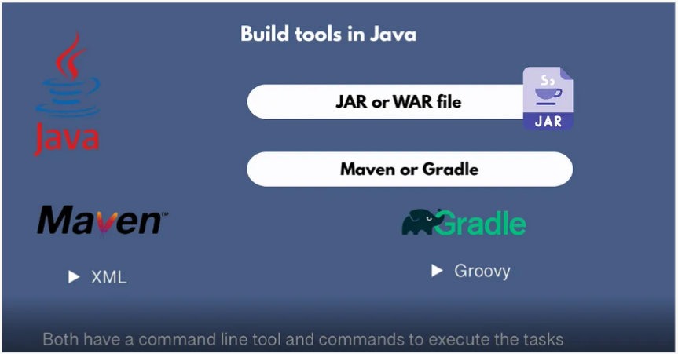
How to Build the artifacts?
These are built using specific tools. Which are specific to the programming language. For example, for Java, it's Maven or Gradle.
These tools install dependencies and compile and compress your code.

Slide 6
Build Tools for programming languages
Java: maven | gradle
JavaScript: npm | yarn | webpack
Python: pip
C/C++: conan
C#: NuGet
Golang: dep
Ruby: RubyGems

Slide 7
Popular Package Management Tools in DevOps
1. npm (Node Package Manager)
For JavaScript: npm is the package manager for JavaScript, primarily used for managing Node.js modules.
Features: Offers an online repository for JavaScript packages and command-line utility for interacting with this repository.
2. Maven and Gradle (for Java)
Maven: Apache Maven provides project management and comprehension tools. It is known for its project object model (POM) approach.
Gradle: An open-source build automation tool focused on flexibility and performance. Gradle is popular for its Groovy-based DSL (Domain Specific Language).
3. Pip (Python)
Python Packages: Pip is the package manager for Python, allowing the installation and management of Python packages from the Python Package Index (PyPI).
Virtual Environments: Often used in conjunction with virtual environments to manage dependencies per project.
4. RubyGems (Ruby)
Ruby Libraries: RubyGems is a package manager for Ruby libraries, providing a standard format for distributing Ruby programs and libraries.
5. NuGet (for .NET)
.NET Packages: NuGet is the package manager for the Microsoft development platform including .NET. It is used to share code across developers and projects.
6. Docker (Container Management)
Containerized Applications: Docker can be considered a package manager for containerized applications, managing Docker images and containers.

Slide 8
Maven Commands
mvn clean
mvn compile
mvn test
mvn package
mvn install
mvn clean (delete target folder)
mvn compile (find classes in src/main/java/* & compile it & store it in target/classes dir)
mvn test/mvn compile test/mvnw compile test (w=repository block) (find test classes in src/test/java/* & compile it then run test)
mvn package/mvn compile test package (compile code, run test & package code in jar/war file)
mvn install/mvn compile test package install (compile code, run test, package code & copy it into local machine in .m2 directory)

Slide 9
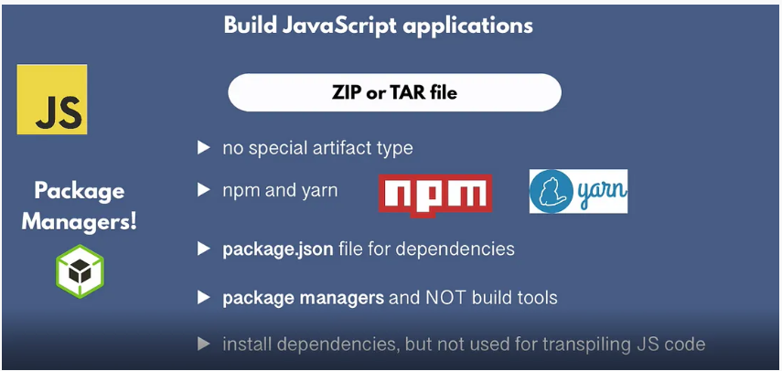
What about JS Applications?
following command is used for installing dependencies . → npm install
Command line tool- npm
npm start -> start the application
npm stop -> stop the application
npm test -> runt the test
npm publish -> publish the artifact

Slide 10
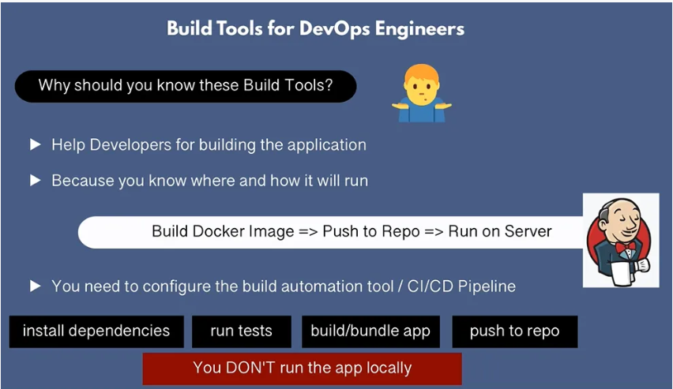

Slide 11
Why should you know these Build Tools as a DevOps engineer?
Help developers building the application, because you know where and how it will run on deployment servers
You need to configure the build automation tool or CI/CD Pipeline, like execute tests on the build servers, build and package into Docker Image, run the application on server
Install dependencies: mvn install, npm install
Run test: mvn test, npm test
Build/bundle app: npm run build, mvn package, docker build
Push to the repository: npm publish, docker push
So, you don't execute anything locally, everything will take care of an automation tool like Jenkins.

Slide 12
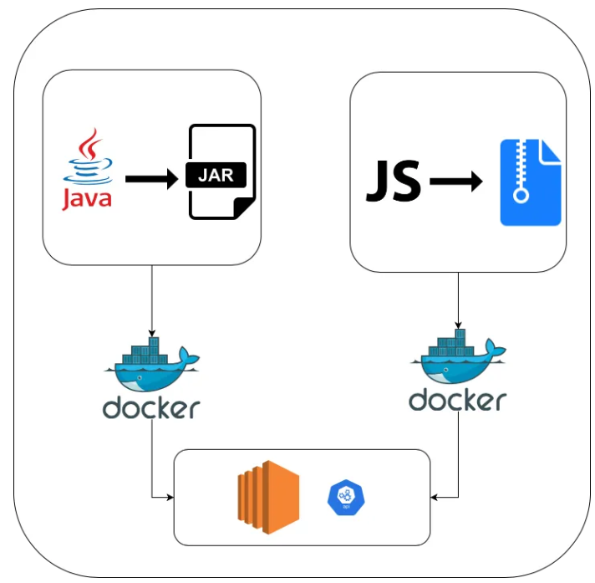
Relation between Build tools and Docker

